Slide 1


Medical CBC Report Analysis
~Kesav Reddy Paderla
B.Tech - AI & DS

Slide 2

Interpreting CBC reports – Challenge for non-medical people
Failure to understand critical values – Delayed needed medication
The goal is to provide clear, accurate, and actionable health insights.
By simplifying CBC interpretation, users can take timely actions.
Provide recommendations to maintain or improve health based on CBC results.
Problem Statement

Slide 3

Extraction
Analysis
Simplify
Validation
Objectives
Explanation
Clarity
Recommendation

Slide 4
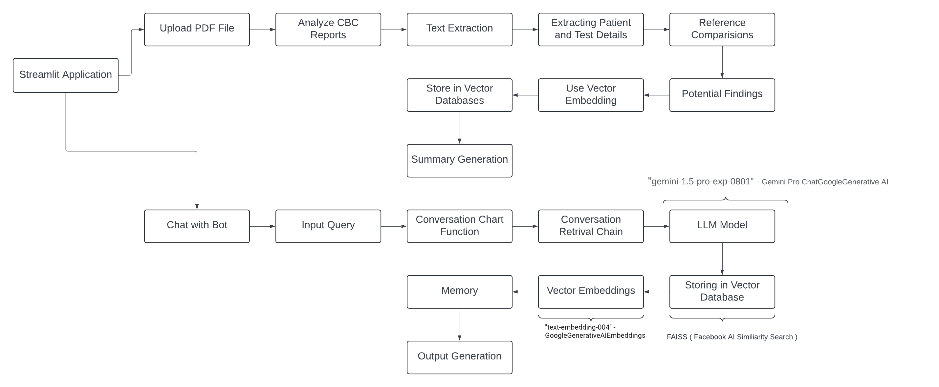
Flowchart

Slide 5
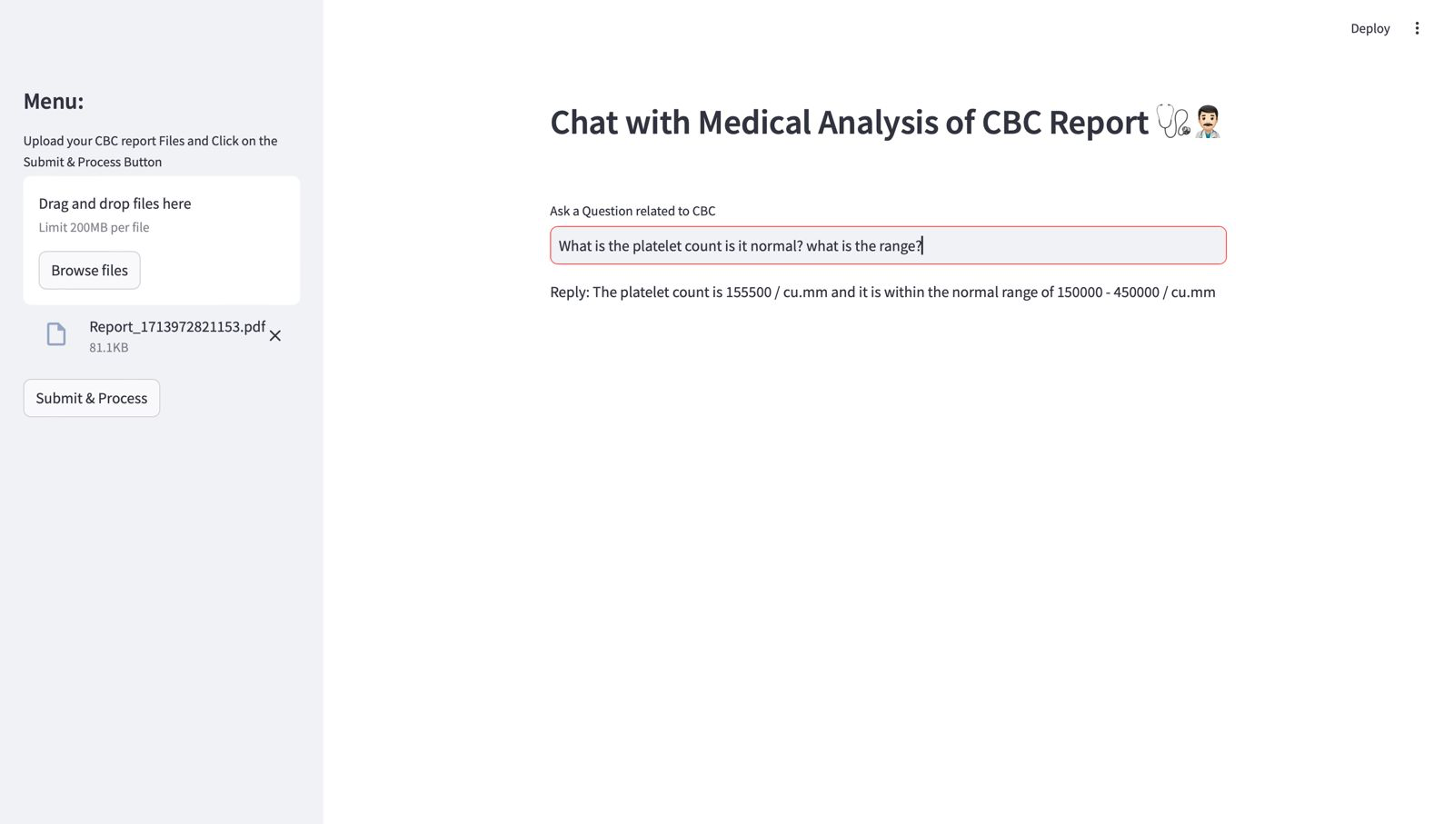
Deployment and results
Streamlit interface and working of CBC Report analyzer

Slide 6
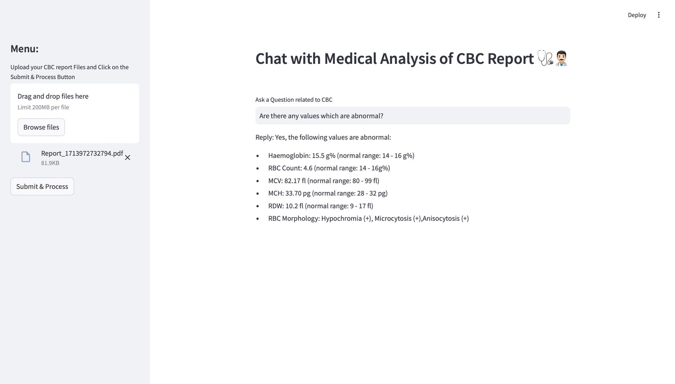
Working of a chatbot

Slide 7
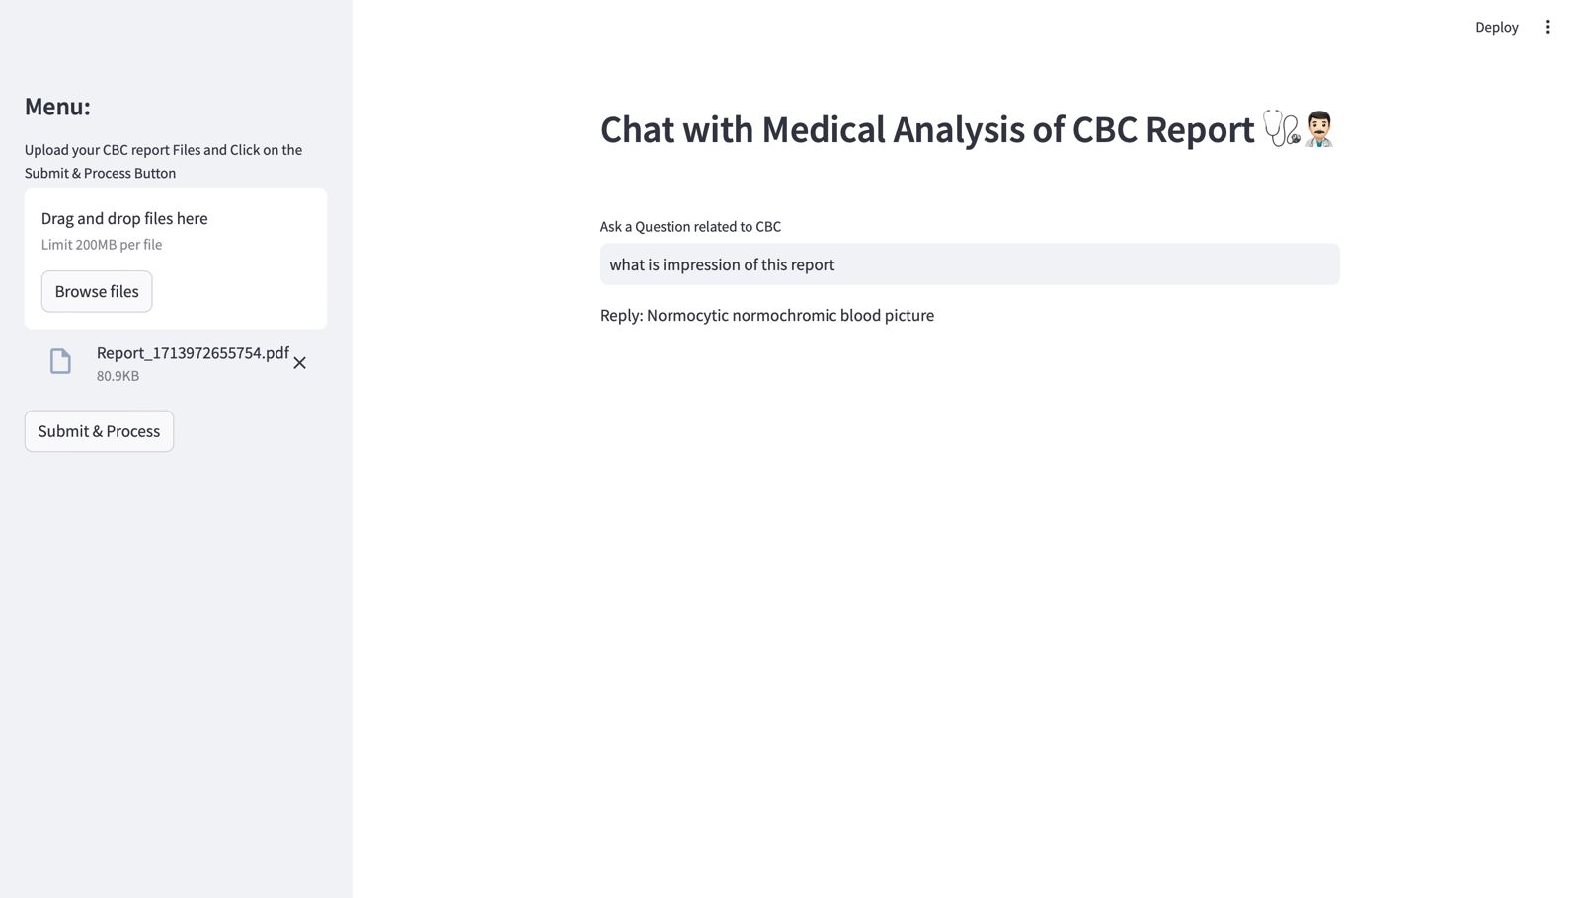
Diagnosing of the Report

Slide 8
Tech Stack Used
Google Generative AI
Gemini-Pro Model
Google Generative AI
Embeddings
PYPDF2
Vector Databases
Streamlit
FAISS
LangChain

Slide 9





Understanding LLM’s
Extraction of data from PDF with various report structures
My Learnings
Natural language processing and embeddings
Building conversational chatbots
Building streamlit application

Slide 10





Future scope and advancements
Option to upload images or scanned CBC report copies
Better summarization
Cloud deployment for faster answer generation
Translation of summary into different languages

Slide 11
Thank
You

